Slide 1
Host Hardening
Chapter 7

Slide 2
Threats to Hosts
The Problem
Some attacks inevitably reach host computers
So servers and other hosts must be hardened— a complex process that requires a diverse set of protections to be implemented on each host
Another name for diverse set of protections is?

Slide 3
Threats to Hosts
What Is a Host?
Anything with an IP address is a host (because it can be attacked)
Servers
Clients (including mobile telephones)
Routers (including home access routers) and sometimes switches
Firewalls

Slide 4
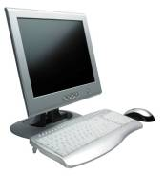
Elements of Host Hardening
Backup
Backup
Backup
Restrict physical access to hosts (see Chapter 5)
Install the operating system with secure configuration options
Change all default passwords, etc.

Slide 5
Change All Default Passwords
Internet Census 2012
A huge Hack!
“While playing around with the Nmap Scripting Engine (NSE) we discovered an amazing number of open embedded devices on the Internet.”
“Two years ago while spending some time with the Nmap Scripting Engine (NSE) someone mentioned that we should try the classic telnet login root:root on random IP addresses.”
Also looked fro admin:admin; admin:blank; root:blank; blank:blank
The vast majority of all unprotected devices are consumer routers or set-top boxes which can be found in groups of thousands of devices. A group consists of machines that have the same CPU and the same amount of RAM. However, there are many small groups of machines that are only available a few to a few hundred times. We took a closer look at some of those devices to see what their purpose might be and quickly found IPSec routers, BGP routers, x86 equipment with crypto accelerator cards, industrial control systems, physical door security systems, big Cisco/Juniper equipment and so on.

Slide 6
Elements of Host Hardening
Minimize the applications that run on the host
Harden all remaining applications on the host (see Chapter 8)
Download and install patches for operating vulnerabilities
Manage users and groups securely
Manage access permissions for users and groups securely

Slide 7
Elements of Host Hardening
Encrypt data if appropriate
Add a host firewall
Read operating system log files regularly for suspicious activity
Run vulnerability tests frequently

Slide 8

Security Baselines and Systems Administrators
Security Baselines Guide the Hardening Effort
Specifications for how hardening should be done
Needed because it is easy to forget a step
Different baselines for different operating systems and versions
Different baselines for servers with different functions (webservers, mail servers, etc.)
Used by systems administrators (server administrators)
Usually do not manage the network

Slide 9
Disk Images
Can also create a well-tested secure implementation for each operating system versions and server function
Save as a disk image
Load the new disk image on new servers

Slide 10
Baseline Checklists
National Institute of Standards and Technology
National Checklist Program
“U.S. government repository of publicly available security checklists (or benchmarks) that provide detailed low level guidance on setting the security configuration of operating systems and applications.”
Example for Internet Explorer….
Center for Internet Security
“not-for-profit organization focused on enhancing the cyber security readiness and response of public and private sector entities, with a commitment to excellence through collaboration.”
Example for Windows 7

Slide 11
Checklists are good but….
Could you imagine how long it would take for that IE checklist to be done/confirmed?
Can this process be automated?
Security Content Automation Protocol (SCAP)
“(SP) 800-126, is ―a suite of specifications that standardize the format and nomenclature by which security software products communicate software flaw and security configuration information.”
automatically verifying the installation of patches
checking system security configuration settings
examining systems for signs of compromise

Slide 12
SCAP Recommendations
Organizations should use SCAP expressed checklists
documents desired security configuration settings, installed patches, and other system security elements in a standardized format
SCAP can be used to demonstrate compliance
SCAP has been mapped to FISMA
Use standard SCAP enumerations
Common Vulnerabilities and Exposures (CVE)
Common Configuration Enumeration (CCE)
Common Platform Enumeration (CPE)
Use SCAP for vulnerability testing and scoring
Provides repeatable measures that can be compared over time
Use SCAP validated products
nCircle Configuration Compliance Manager
Vendors should adopt SCAP

Slide 13
Virtualization
Multiple operating systems running independently on the same physical machine
System resources are shared
Increased fault tolerance
Rapid and consistent deployment
Reduced labor costs

Slide 14
Vulnerabilities and Exploits
Vulnerabilities
Security weaknesses that open a program to attack
An exploit takes advantage of a vulnerability
Vendors develop fixes
Zero-day exploits: exploits that occur before fixes are released
Exploits often follow the vendor release of fixes within days or even hours
Companies must apply fixes quickly

Slide 15
Vulnerabilities and Exploits
Fixes
Work-arounds
Manual actions to be taken
Labor-intensive so expensive and error-prone
Patches:
Small programs that fix vulnerabilities
Usually easy to download and install
Service packs (groups of fixes in Windows)
Version upgrades

Slide 16
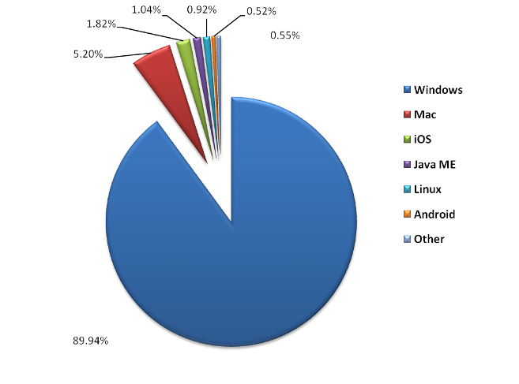
Operating System Market Share

Slide 17
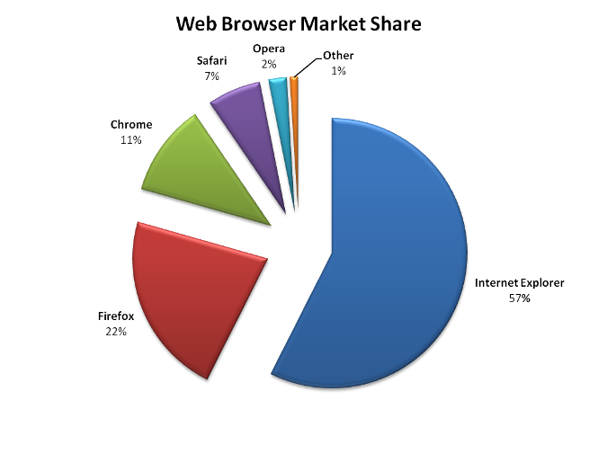
Web Browser Market Share

Slide 18
Applying Patching
Problems with Patching
Must find operating system patches
Windows Server does this automatically
LINUX versions often use rpm
Companies get overwhelmed by number of patches
Latest figures by CERT in 2008
44,000 vulnerabilities catalogued
Use many programs; vendors release many patches per product
Especially a problem for a firm’s many application programs

Slide 19
Applying Patching
Problems with Patching
Cost of patch installation
Each patch takes some time and labor costs
Usually lack the resources to apply all
Prioritization
Prioritize patches by criticality
May not apply all patches, if risk analysis does not justify them

Slide 20
Compliance or Security, What Cost?
Craig Wright, 2011

Slide 21
Hypothesis/Background
Audits are geared towards expressing compliance with IT Security vs. tests of IT Security controls
Data collection
2,361 audit reports from 1998-2010
Australian and US audits
SOX, PCI-DSS, APRA, BASELII, AML-CTF

Slide 22
Findings
30% of tests evaluated effectiveness of the control process
System security was only validated in 6.5% of reports
By testing that controls met the documented process
NOT by testing the controls
Only 32 of 542 organizations utilized baseline templates

Slide 23
Patch Compliance Findings
 | # Analyzed | Days Between Patch | Policy Patch Time | Prior Audit Reports Noting Patching
Windows Server | 1571 | 86.2 (mean) | 56-88 (CI) | 98.4%
Windows Clients | 13591 | 48.1 | 30-49 | 96.6%
Other Windows Applications | 30290 | 125.2 | 68 without patch | 18.15%
Internet facing routers | 515 | 114.2 | 58.1 | 8.7%
Internal Routers | 1323 | 267.8 | 73.2 | 3.99%
Internal Switches | 452 | 341.2 | 87.5 | 1.2%
Firewalls | 1562 | 45.4 | 25-108 | 70.7%

Slide 24


Managing Users and Groups
XYZ
Accounts
Every user must have an account
Groups
Individual accounts can be consolidated into groups
Can assign security measures to groups
Inherited by each group’s individual members
Reduces cost compared to assigning to individuals
Reduces errors
XYZ

Slide 25
The Super User Account
Super User Account
Every operating system has a super user account
The owner of this account can do anything
Called Administrator in Windows
Called root in UNIX
Hacking Root
Goal is to take over the super user account
Will then “own the box”
“rooted”

Slide 26
The Super User Account
Appropriate Use of a Super User Account
Log in as an ordinary user
Switch to super user only when needed
In Windows, the command is RunAs
In UNIX, the command is su (switch user)
Quickly revert to ordinary account when super user privileges are no longer needed

Slide 27

Permissions
Specify what the user or group can do to files, directories, and subdirectories
Assigning Permissions in Windows
Right-click on file or directory
Select Properties, then Security tab
Select a user or group
Select the 6 standard permissions (permit or deny)
For more fine-grained control, 13 special permissions

Slide 28
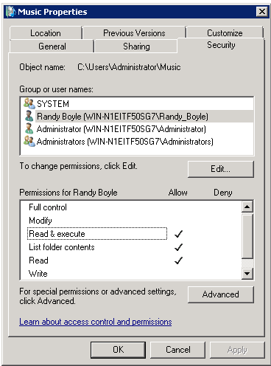
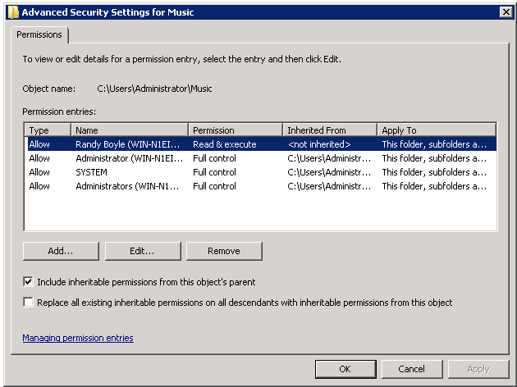
Assigning Permissions in Windows
Select a user or group
Inheritable permissions
Standard permissions
Advanced permissions

Slide 29
The Inheritance of Permission
Inheritance
If the Include inheritable permissions from this object’s parent is checked in the security tab, the directory receives the permissions of the parent directory.
This box is checked by default, so inheritance from the parent is the default

Slide 30

The Inheritance of Permission
XYZ
Inheritance
Total permissions include
Inherited permissions (if any)
Plus the Allow permissions checked in the Security tab
Minus the Deny permissions checked in the Security tab
The result is the permissions level for a directory or file
XYZ

Slide 31
The Inheritance of Permission
Directory Organization
Proper directory organization can make inheritance a great tool for avoiding labor
Example: Suppose the all logged-in user group is given read and execute permissions in the public programs directory
Then all programs in this directory and its subdirectories will have read and execute permissions for everyone who is logged in
There is no need to assign permissions to subdirectories and their files

Slide 32
Windows vs. Unix
Category | Windows | UNIX
Number of permissions | 6 standard, 13 specialized if needed | Only 3: read (read only), write (make changes), and execute (for programs). Referred to as rwx
For a file or directory, different permissions can be assigned to | Any number of individual accounts and groups | The account owner A single group, and All other accounts

Slide 33
Vulnerability Testing
Mistakes Will Be Made in Hardening
So do vulnerability testing
Run Vulnerability Testing Software on Another Computer
Run the software against the hosts to be tested
Interpret the reports about problems found on the server
This requires extensive security expertise
Fix them

Slide 34
Get Permission for Vulnerability Testing
Looks like an attack
Must get prior written agreement
Vulnerability testing plan
An exact list of testing activities
Approval in writing to cover the tester
Supervisor must agree, in writing, to hold the tester blameless if there is damage
Tester must not diverge from the plan

Slide 35
Windows Client PC Security
Client PC Security Baselines
For each version of each operating system
Within an operating system, for different types of computers (desktop versus notebook, in-site versus external, high-risk versus normal risk, and so forth)
Automatic Updates for Security Patches
Completely automatic updating is the only reasonable policy

Slide 36

Windows Client PC Security
Antivirus and Antispyware Protection
Important to know the status of antivirus protection
Users turn off deliberately or turn off automatic updating for virus signatures
Users do not pay the annual subscription and so get no more updates
Windows Advanced Firewall
Stateful inspection firewall
Accessed through the Windows Action Center

Slide 37
Centralized PC Security Management
Importance
Ordinary users lack the knowledge to manage security on their PCs
They sometimes knowingly violate security policies
Also, centralized management often can reduce costs through automation

Slide 38
Standard Configurations for PCs
May restrict applications, configuration settings, and even the user interface
Ensure that the software is configured safely
Enforce policies
More generally, reduce maintenance costs by making it easier to diagnose errors

Slide 39



Centralized PC Security Management
Network Access Control (NAC)
Goal is to reduce the danger created by computers with malware
Control their access to the network
Network

Slide 40
Centralized PC Security Management
Network Access Control (NAC)
Stage 1: Initial Health Check
Checks the “health” of the computer before allowing it into the network
Choices:
Accept it
Reject it
Quarantine and pass it to a remediation server; retest after remediation

Slide 41
Centralized PC Security Management
Network Access Control (NAC)
Stage 2: Ongoing Traffic Monitoring
If traffic after admission indicates malware on the client, drop or remediate
Not all NAC systems do this

Slide 42
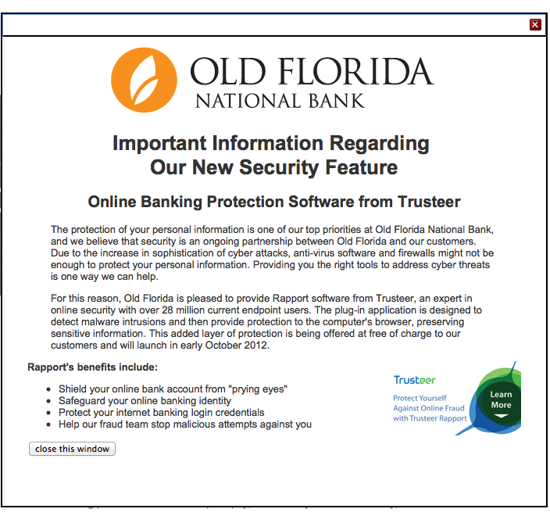
The Future is Now??

Slide 43
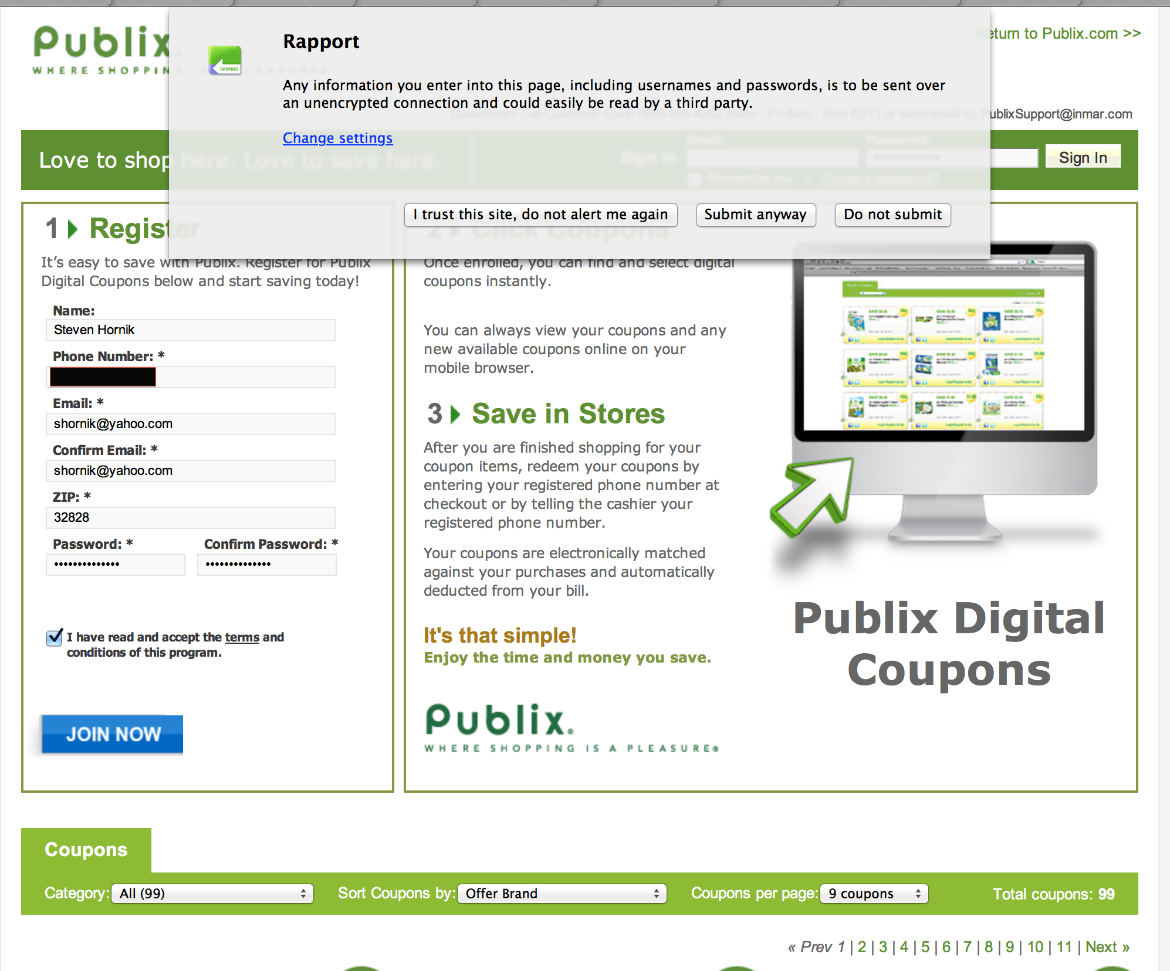

Slide 44
Application Security
Chapter 8

Slide 45
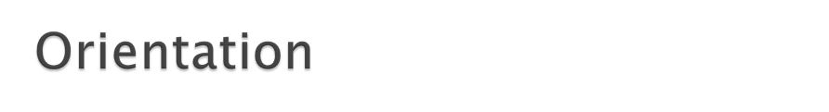
Some attacks inevitably get through network protections and reach individual hosts
In Chapter 7, we looked at host hardening
In Chapter 8, we look at application hardening
In Chapter 9, we will look at data protection

Slide 46


Application Security Threats
Executing Commands with the Privileges of a Compromised Application
If an attacker takes over an application, the attacker can execute commands with the privileges of that application
Many applications run with super user (root) privileges

Slide 47
Hardening Applications
Add Application Layer Authentication, Authorizations, and Auditing
More specific to the needs of the application than general operating system logins
Can lead to different permissions for different users
Implement Cryptographic Systems
For communication with users

Slide 48
Hardening Applications
Basics
Physical Security
Backup
Harden the Operating System
Etc.
Minimize Applications
Main applications
Subsidiary applications
Wordpress Plugins (mydebitcredit.com)
Will see why later….
Be guided by security baselines

Slide 49
Hardening Applications
Create Secure Application Program Configurations
Use baselines to go beyond default installation configurations for high-value targets
Avoid blank passwords or well-known default passwords
Install Patches for All Applications
Minimize the Permissions of Applications
If an attack compromises an application with low permissions, will not own the computer

Slide 50

Securing Custom Applications
Custom Applications
Written by a firms programmers
Not likely to be well trained in secure coding
The Key Principle
Never trust user input
Filter user input for inappropriate content

Slide 51
Secure Coding vs. Software Quality
Software Quality Testing
Use of Structured Design Process (SAD)
Testing to eliminate as many bugs as possible
Variations of likely data input to uncover bugs
Focus is on triggering bugs and fixing flaw
Secure Coding
Attacker targets a known bug and exploits it
Triggered by input much different than that tested for during software quality, thus not likely caught during QA
Increase Time and amount of Code needed
Conflicts with Business pressures for SAD

Slide 52
Programming
Input
Processing
Output
We’ll examine only Input…

Slide 53
Program Input
Most common points of failure
Input is:
Any data that originates from outside of the application
Keyboard
Files
Network connections
Data from operating environment
Configuration settings
Data value is not known by the programmer when code is written (a variable)
Data size and Data type have to be verified by code

Slide 54
Program Input
Data Interpretation
What data is being input
What is the meaning of the data
Data Input can be:
Textual
Binary
0’s and 1’s are interpreted as:
Integers, floating point numbers, character strings
Must be validated
Meaning of Data
Is it a URL
Email Address
Integer

Slide 55
Fuzzing
Professor Barton Miller – University of Wisconsin Madison
Software that randomly generates data as test input
Textual
Graphical
Network Requests
Parameter Values
Identifies simple faults related to improper input validation
If a bug exists that is only triggered by a small number of very specific input it might not be found

Slide 56
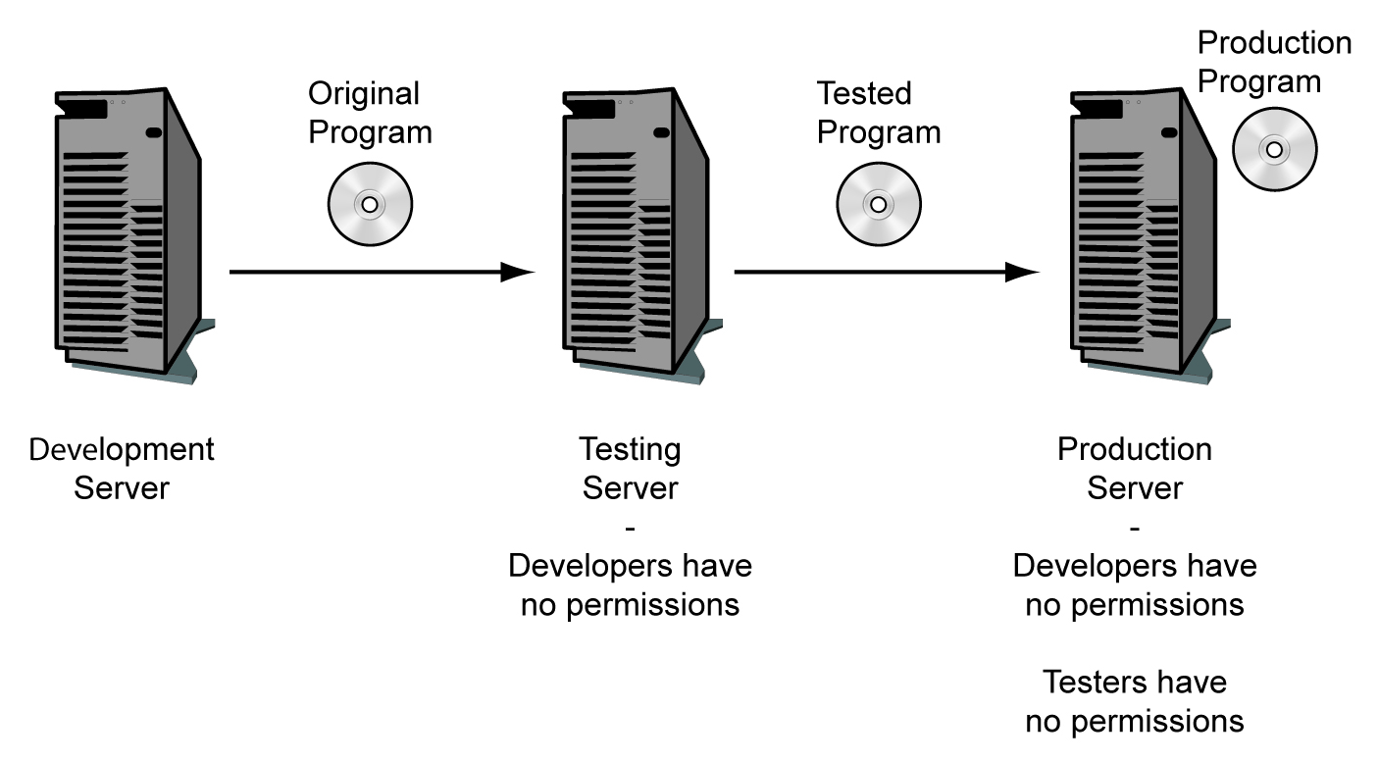
When developing Applications

Slide 57
SANS Institute
One of the most important findings in cybersecurity over the past several years has been the understanding most often asserted by White House officials that "offense must inform defense." Only people who understand how attacks are carried out can be expected to be effective defenders.

Slide 58
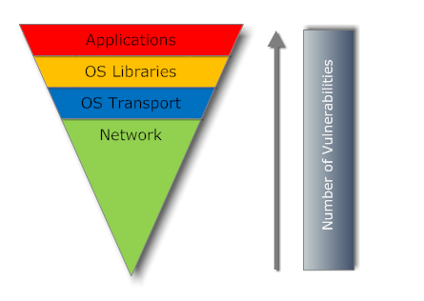
SANS Institute

Slide 59
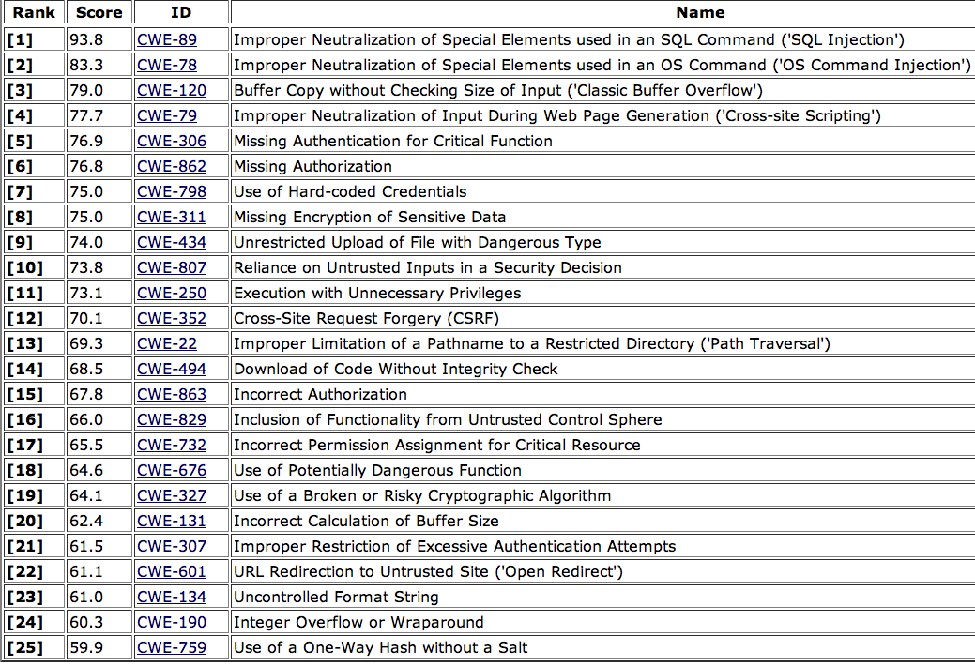
Top 25 Application Vulnerabilities (Sans Institute)

Slide 60
We are not the Programmers
But if we don't understand these vulnerabilities
We Cant ask the correct questions
We Cant deploy the proper controls
We Cant test the controls are working

Slide 61
Application Vulnerabilities
Buffer Overflows
Stack Overflows
Cross-Site Scripting (XSS)
SQL-Injection

Slide 62
Application Security Threats
Buffer Overflow Attacks
Buffers are places where data is stored temporarily
A condition at an interface under which more input can be placed into a buffer or data holding area than the capacity allocated, overwriting other information.
Consequences include:
Corruption of data
Unexpected transfer of control (to an unauthorized program)
Memory access violations
Program termination

Slide 63
Application
Application
Variables
Variables
Overwrites
Return
Address
Return Address
New Return Address
Exploit/ShellCode
Lets say this is computer memory running an application.
The application is paused to get data
So the address of where the application is before interruption is stored
So we can return after getting data, but the return address is overwritten and after the pause, a new program begins processing

Slide 64
What the Attacker Needs
Identify existence of a buffer overflow vulnerability
Application must require external data that the attacker can control
Understanding of how buffer will be stored in memory

Slide 65
How do Attackers get this?
Inspect Code
Fuzzing

Slide 66
Exploit / ShellCode
Specifically written for:
A particular processor (e.g. Intel)
A particular Operating System (Windows XP SP3)
A particular Application
Written in Machine code
Requires High level of Expertise
But Not anymore….
Metaspolit Project

Slide 67
Defending Against Buffer Overflows
Compile-Time Defenses
Harden Program Code
Run-Time Defenses
Detect and Abort Buffer Overflow Attacks

Slide 68
Compile-Time Hardening
Choose High-Level Program Language
Higher level languages better address
Data Types (text is text, integer is integer)
Better controls over data type manipulations
Perform range checks
Downside Cost
Further away from underlying machine language
May not be able to access certain instructions and hardware resources may be lost
May not be possible to use these languages for
Device Drivers

Slide 69
Compile-Time Hardening
Safe Coding Techniques
Programmers need to inspect code for Security
Coding for Graceful Failure
Any Code written to a buffer must FIRST check to ensure sufficient space is available

Slide 70
Compile-Time Hardening
Stack Protection
Program Entry and Exit code checks for evidence of corruption
If found program is aborted
Example:
Stackgaurd
Uses a “Canary” value which is inserted in memory right below the return address
This value is known
A check of this value at the known memory location before using a return address can determine if overflow changes occurred

Slide 71
Compile-Time Hardening
Stack Protection
Stackshield and Return Address Defender (RAD)
When new function is called, return address is copied to a safe area of memory
When function is finished, the Return Address in stack is compared against address in safe memory

Slide 72
Run-Time Defenses
Executable Address Space Protection
Do Not allow executable code (applications) to run from the buffer
Address Space Randomization
Change location of buffer in memory randomly for each process being run.
Guard Pages
Gaps are placed between memory locations, thus overflow data goes into gaps and does not Overwrite data
If data is written to one of these gaps, the program is aborted

Slide 73
Injection Attacks
Input data accidently or deliberately changes the operations of the program.
Happens often when input data are passed between functions of a program as parameters (variables)
Input to one program is Output to another
SQL injection
SQL query inserted as input or part of input
Code injection
Code that is executed by the system (e.g. buffer overflow)

Slide 74
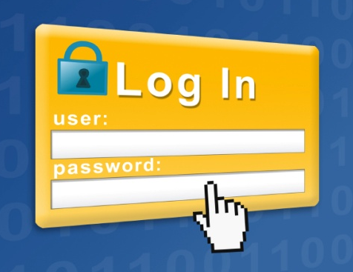
Securing Custom Applications
Login Screen Bypass Attacks
Website user gets to a login screen
Instead of logging in, enters a URL for a page that should only be accessible to authorized users

Slide 75
Securing Custom Applications
Cross-Site Scripting (XSS) Attacks
One user’s input can go to another users webpage
Usually caused if a website sends back information sent to it without checking for data type, scripts, etc.
Example, If you type your username, it may include something like, “Hello username” in the webpage it sends you

Slide 76
Securing Custom Applications
Example
Attacker sends the intended victim an e-mail message with a link to a legitimate site
However, the link includes a script that is not visible in the browser window because it is beyond the end of the window
The intended victim clicks on the link and is taken to the legitimate webpage
The URL’s script is sent to the webserver with the HTTP GET command to retrieve the legitimate webpage

Slide 77
Securing Custom Applications
Example
The webserver sends back a webpage including the script
The script is invisible to the user (browsers do not display scripts)
But the script executes
The script may exploit a vulnerability in the browser or another part of the user’s software
Comment Example
Hey I really liked that blog post
<script>document.location=‘http://hacker.web.site’</script>

Slide 78
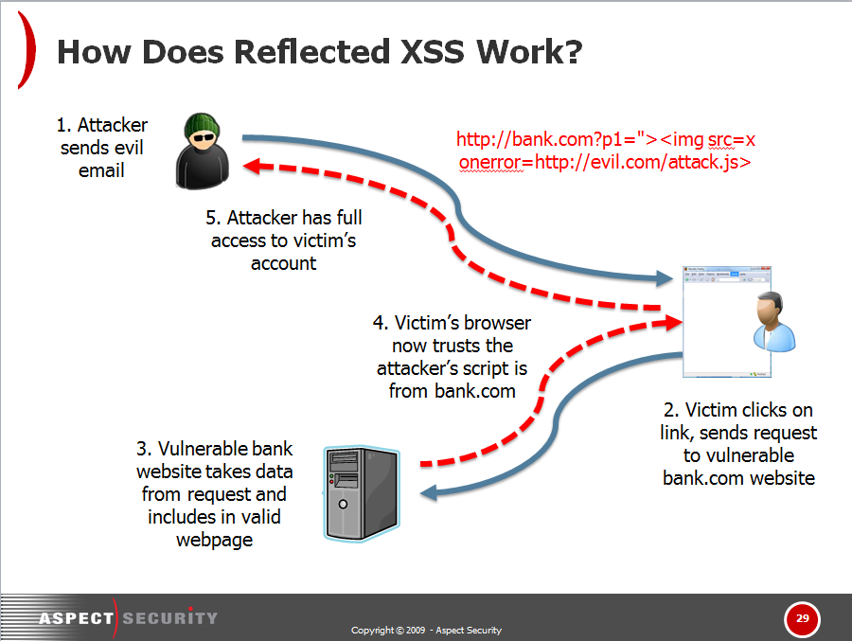
Yahoo Developer Network Attack

Slide 79
Preventing XSS
Input data should be inspected
Sounds easy, look for <script> as part of input and block…. But
HTML character entries
&#60; = <
Input should be compared to what is wanted by the program
NOT against known dangerous values
See Encoding above

Slide 80
Securing Custom Applications
SQL Injection Attacks
For database access
Programmer expects an input value—a text string, number, etc.
May use it as part of an SQL query or operation against the database
Say to accept a last name as input and return the person’s telephone number

Slide 81
Securing Custom Applications
SQL Injection Attacks
Attacker enters an unexpected string
For example: a last name followed by a full SQL query string
Bob’ drop table suppliers==
The program may execute both the telephone number lookup command and the extra SQL query
This may look up information that should not be available to the attacker
It may even delete an entire table

Slide 82
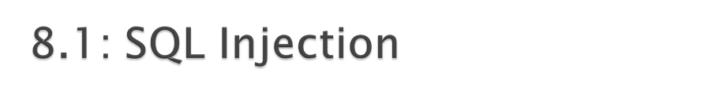
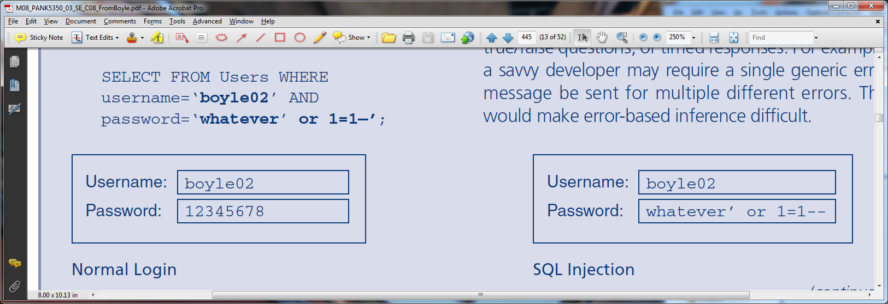

Slide 83
Securing Custom Applications
Must Require Strong Secure Programming Training
General principles
Programming-language-specific information
Application-specific threats and countermeasures

Slide 84

Application Security Threats
Few Operating Systems but Many Applications
Application hardening is more total work than operating system hardening
Understanding the Server’s Role and Threat Environment
Just run minimum necessary applications on a server
If Email, just run email

Slide 85

Browser Attacks and Protections
PCs Are Major Targets
Have interesting information and can be attacked through the browser
Client-Side Scripting (Mobile Code)
Java applets: Small Java programs
Usually run in a “sandbox” that limits their access to most of the system
Active-X from Microsoft; highly dangerous because it can do almost everything

Slide 86
8.3: Browser Attacks and Protections
Client-Side Scripting (Mobile Code)
Scripting languages (not full programming languages)
A script is a series of commands in a scripting language
JavaScript (not scripted form of Java)
VBScript (Visual Basic scripting from Microsoft)
A script usually is invisible to users

Slide 87
Browser Attacks and Protections
You like beef?
click here.
Malicious Links
User usually must click on them to execute (but not always)
Tricking users to visit attacker websites
Social engineering to persuade the victim to click on a link
Choose domain names that are common misspellings of popular domain names
http://www.micosoft.com

Slide 88
Browser Attacks and Protections
Other Client-Side Attacks
Automatic redirection to unwanted webpage
On compromised systems, the user may be automatically directed to a specific malicious website if they later make any typing error

Slide 89
Browser Attacks and Protections
Other Client-Side Attacks
Cookies
Cookies are placed on user computer; can be retrieved by website
Can be used to track users at a website
Can contain private information
Accepting cookies is necessary to use many websites

Slide 90
Browser Attacks and Protections
Enhancing Browser Security
Patches and updates
Set strong security configuration options (Figure 8-12) for Microsoft Internet Explorer
Set strong privacy configuration options (Figure 8-13) for Microsoft Internet Explorer

Slide 91
My Hack
mydebitcredit.com

Slide 92
My Hack
Hello,During a recent security scan on our servers it has come to our attention one of your DreamHost hosted websites have been compromised. It would appear that an unknown malicious party has modified your site's .htaccess file in order to redirect traffic destined for your website to their own site (or you have become generous and chose to re-route your site's traffic to a "sweepstakes and contests info" website.)

Slide 93
I’ve been Hacked!
mydebitcredit.com
Reviewing one of the disabled files, this is the malicious code that was injected at the beginning of the file:<?php /**/eval(base64_decode("aWYoZnVuY3Rpb25fZXhpc3RzKCdvYl9zdGFydCcpJiYhaXNzZXQo... (this continues on)

Slide 94
My Hack – Recovery
First I wanted to understand so I opened some of the infected files – with my Virus Scanner on!
Found I had (many files infected with)
Troj/PHPShll-B
Downloads more malware
Downloads code from the Internet
Does not allow me to edit and clean infected files
So…
Restore from Backup

Slide 95
My Hack – Restore from Backup
I was lucky, in a sense?
My blog is not very active
So backing up from a early period did not loose any content
I deleted all the old directories
But kept the latest one (for investigating)
Not a good idea,
I got re-hacked
So I deleted again and tried to re-harden my site

Slide 96
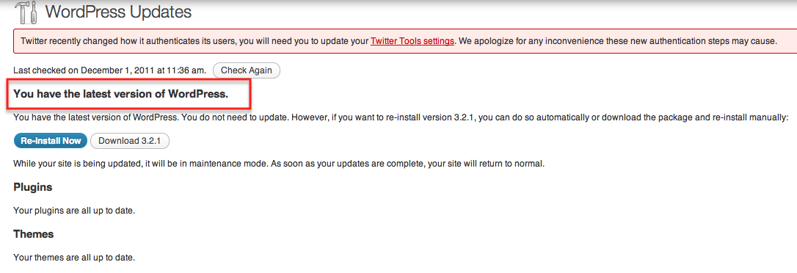
My Hack - Software
After initial restore
Updated WordPress admin password
It wasn’t “admin”
Updated WordPress to latest version
I updated my Plugins

Slide 97
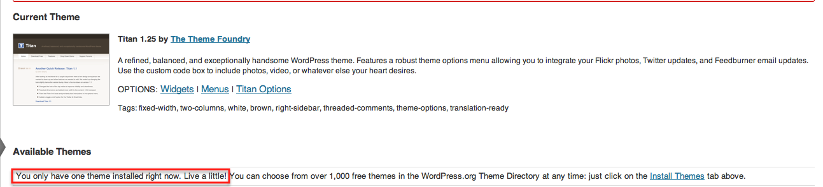
My Hack - Software
Remember I said I was hacked again
I forgot to update my themes
Wordpress themes are usually PHP code
Determines blog look and behavior
Mine was not updated
So I updated it…
I had 69 out of date themes!!!!!!

Slide 98
My Hack – Make it Better
The file hacked was .htaccess
So I found a site that had code for hardening this file:
WebDesignCode
And changed my code
But still things were fishy so I emailed DreamHost Abuse and this is what else they did….

Slide 99
My Hack – DreamHost Abuse Response
I deleted the new .htaccess file that was placed in my root directory
Though my site was available:
Mydebitcredit.com
My Permalinks were broken
The direct link to an blog post
404 errors
So DreamHost, so changed permalinks
I have an unused Domain that was a vector for some of the virus
Deleted two files:
./robinshermano.com/evangelin_stepped.php---------- 1 shornik pg1249160 28278 2011-08-05 13:12
./robinshermano.com/maryanna_gennie.php

Slide 100
My Hack – DreamHost Response
File/Directory Permissions
When we've seen files that match that naming convention and size signature arise over the last couple of months, it is typically due to the folder that it resides in having insecure 777 permission settings that allow for the global writing of files by any user. This means that if another user on the shared server is hacked, the attackers, if they scan for folders with this insecure setting can then place files in the folder , such as the above listed backdoor shell which they later hit via HTTP to inject a base64 encoded payload into your files.

Slide 101
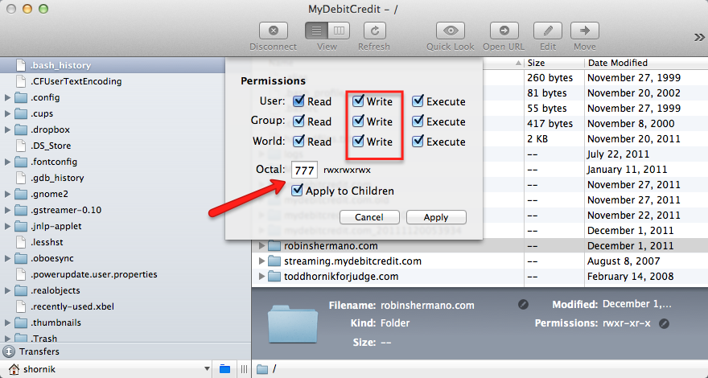
My Hack - Permissions

Slide 102
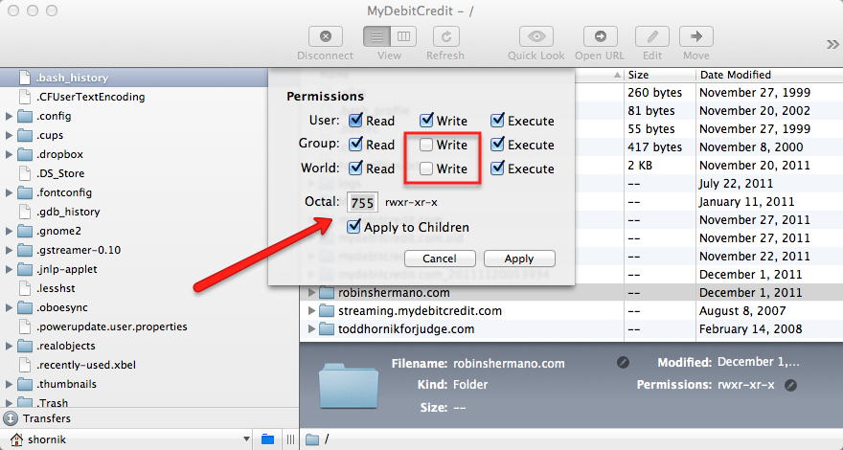
My Hack - Permissions

Slide 103
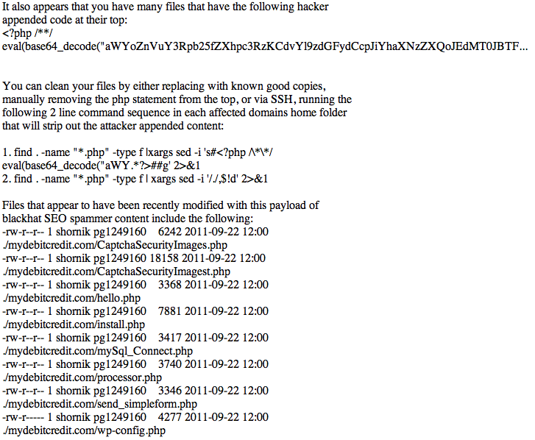
My Hack – I’m still not done

Slide 104
And…
CloudFlare
“CloudFlare leverages the knowledge of a diverse community of websites to power a new type of security service. Online threats range from nuisances like comment spam and excessive bot crawling to malicious attacks like SQL injection and denial of service (DOS) attacks. CloudFlare provides security protection against all of these types of threats and more to keep your website safe.”

Slide 105
It’s more than you think…
Chapter 7 – Operating Systems / Hosts
Chapter 8 – Applications
Chapter 9 – Data
But social networks connect us with everything….
Permissions

